Slide 1

Lecture 4:
Nonideal Transistor Theory

Slide 2
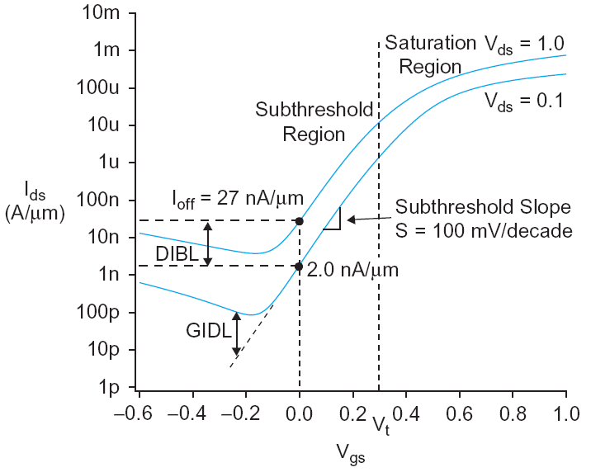
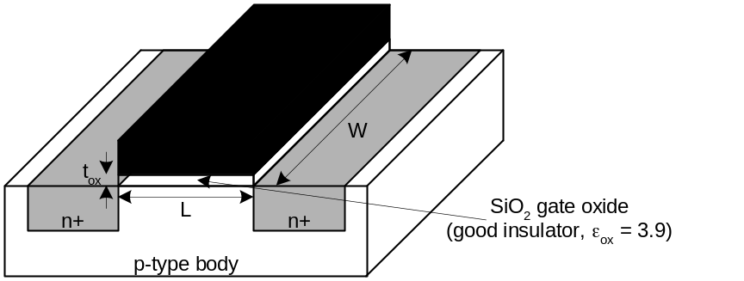
Outline
Nonideal Transistor Behavior
  High Field Effects
    Mobility Degradation
    Velocity Saturation
  Channel Length Modulation
  Threshold Voltage Effects
    Body Effect
    Drain-Induced Barrier Lowering(DIBL)
    Short Channel Effect
  Leakage
    Subthreshold Leakage
    Gate Leakage
    Junction Leakage
Process and Environmental Variations
4: Nonideal Transistor Theory

Slide 3
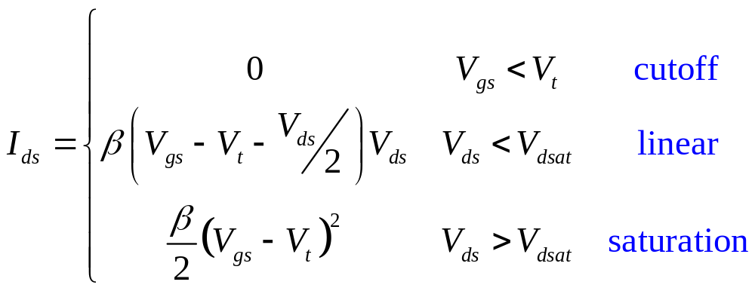

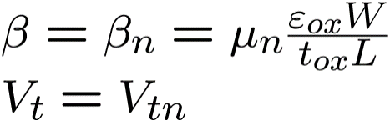
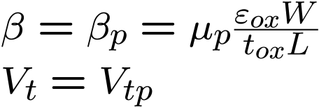
Ideal Transistor I-V
Shockley long-channel transistor models
_{for nMOS}
_{for pMOS}
4: Nonideal Transistor Theory

Slide 4
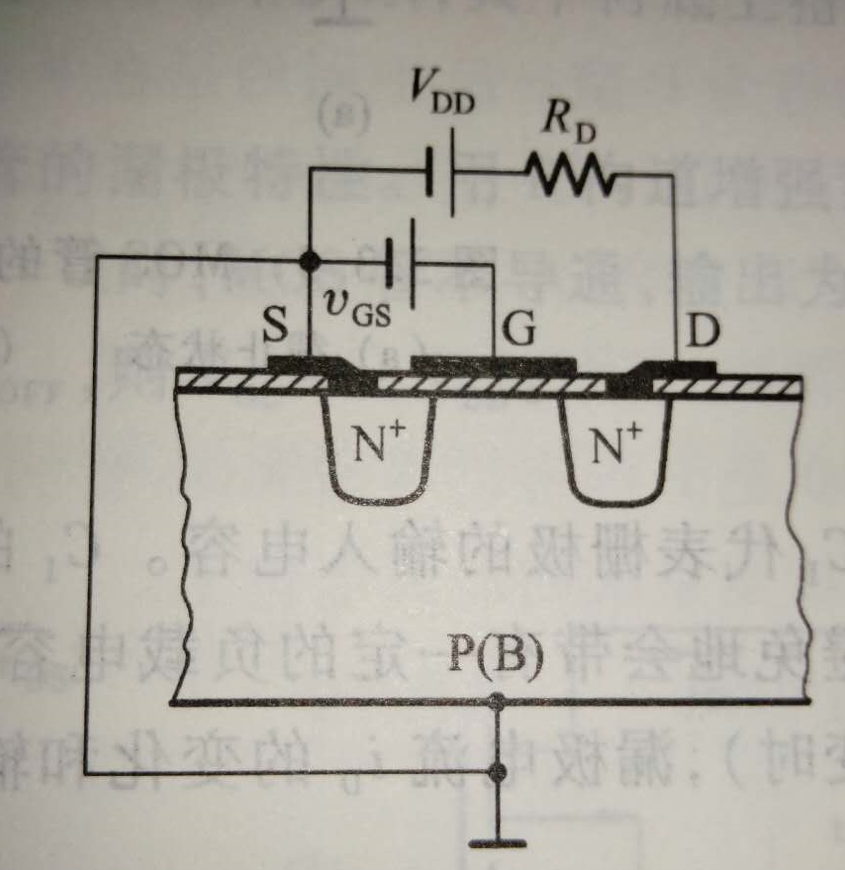
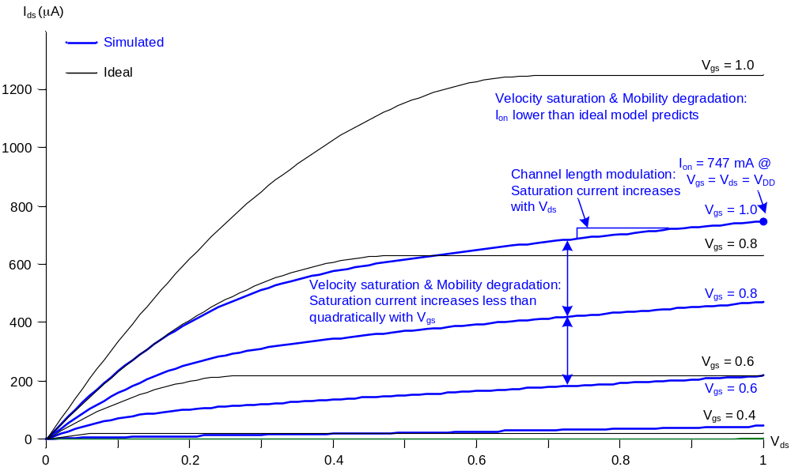
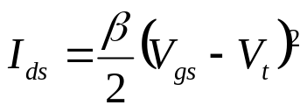
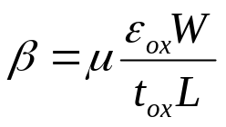
Ideal vs. Simulated nMOS I-V Plot
65 nm IBM process, V_{DD} = 1.0 V
4: Nonideal Transistor Theory

Slide 5
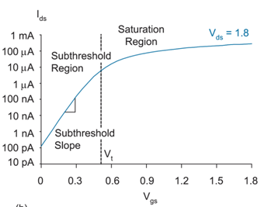
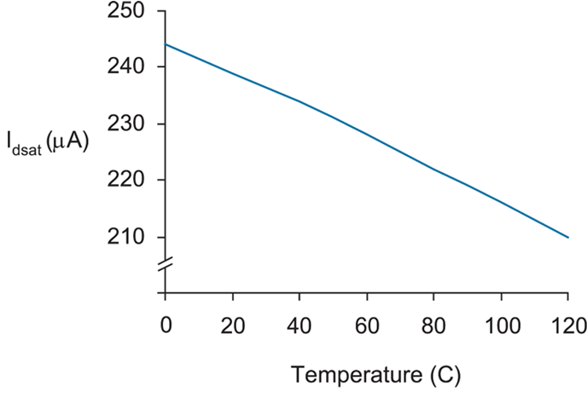
Continue
_{180nm process}
There is leakage current when the transistor is in cut off
_{Ids depends on the temperature}
4: Nonideal Transistor Theory

Slide 6
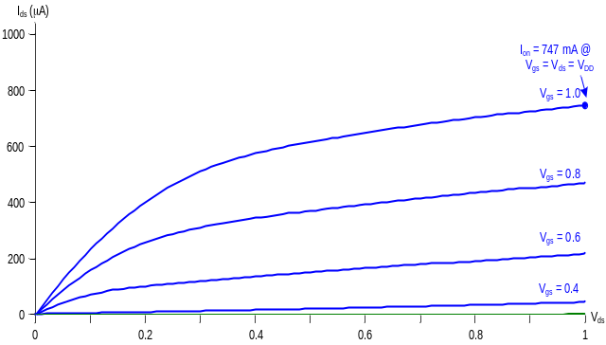
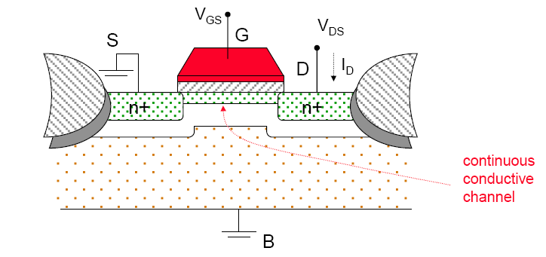
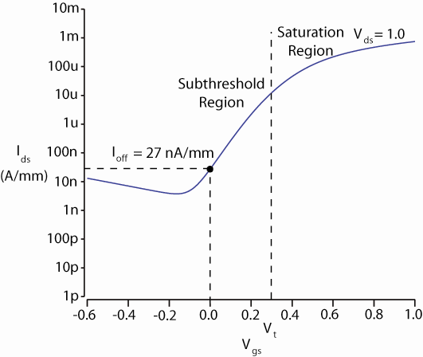
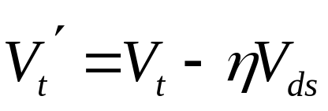
ON and OFF Current
I_{on} = I_{ds} @ V_{gs} = V_{ds} = V_{DD}
  Saturation
I_{off} = I_{ds} @ V_{gs} = 0, V_{ds} = V_{DD}
  Cutoff
4: Nonideal Transistor Theory

Slide 7
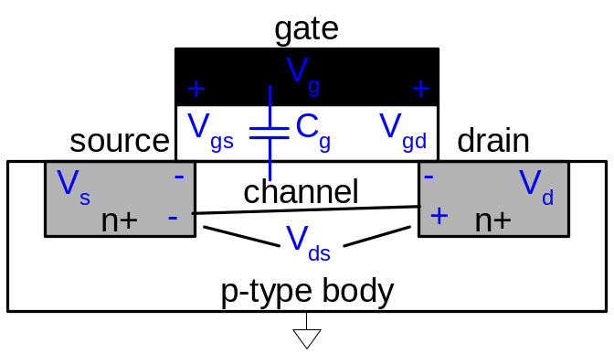
Electric Fields Effects
Vertical electric field: E_{vert} = V_{gs} / t_{ox}
  Attracts carriers into channel
  Long channel: Q_{channel} = CV∝ E_{vert}
Lateral electric field: E_{lat} = V_{ds} / L
  Accelerates carriers from drain to source
  Long channel: v = μE_{lat}
  t = L / v
  I=Q/t
4: Nonideal Transistor Theory

Slide 8
Coffee Cart Analogy
Tired student runs from VLSI lab to coffee cart
Freshmen are pouring out of the physics lecture hall
V_{ds} is how long you have been up
  Your velocity = fatigue × mobility
V_{gs} is a wind blowing you against the glass (SiO₂) wall
At high V_{gs}, you are buffeted against the wall
  Mobility degradation
At high V_{ds}, you scatter off freshmen, fall down, get up
  Velocity saturation
    Don’t confuse this with the saturation region
4: Nonideal Transistor Theory

Slide 9
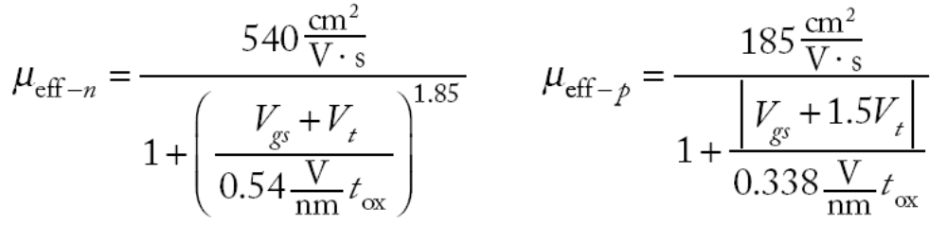
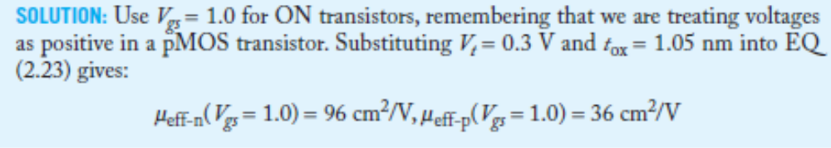
Mobility Degradation
High E_{vert} effectively reduces mobility
  Collisions with oxide interface
4: Nonideal Transistor Theory

Slide 10
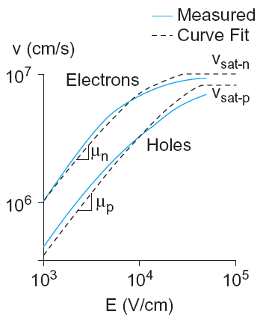
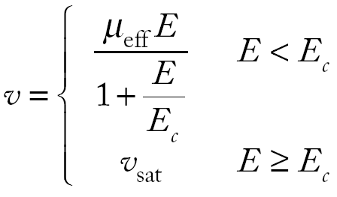
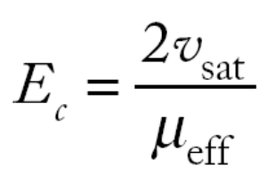

Velocity Saturation
At high E_{lat}, carrier velocity rolls off
  Carriers scatter off atoms in silicon lattice
  Velocity reaches v_{sat}
    Electrons: 10⁷ cm/s
    Holes: 8 x 10⁶ cm/s
  Better model
4: Nonideal Transistor Theory

Slide 11
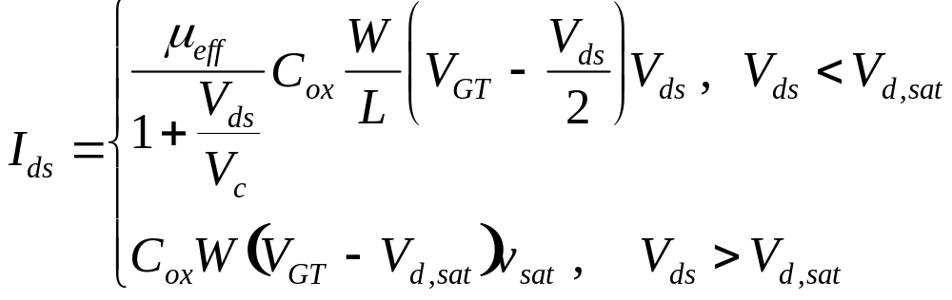
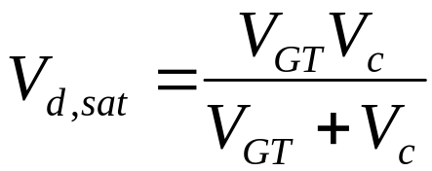
Velocity Saturation
Substituting,
Note that μ_{eff} is also a function of V_{GT} due to mobility degradation.
Equating the two equations above at the boundary V_{ds} = V_{d,sat}
4: Nonideal Transistor Theory

Slide 12
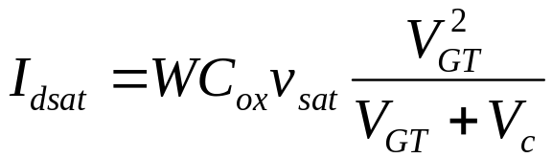

Velocity Saturation
Substituting this value in the velocity saturated regime,
For V_{GT} << V_{c}, the equation reduces to the square law model.
For V_{GT} >> V_{c}, the the equation becomes
4: Nonideal Transistor Theory

Slide 13
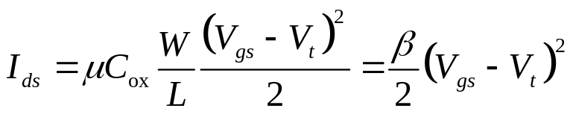
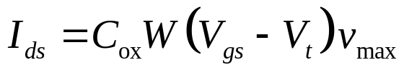
Vel Sat I-V Effects
Ideal transistor ON current increases with V_{DD}²
Velocity-saturated ON current increases with V_{DD}
Real transistors are partially velocity saturated
  Approximate with α-power law model
  I_{ds} ∝ V_{DD}^{α}
  1 < α < 2 determined empirically (≈ 1.3 for 65 nm)
4: Nonideal Transistor Theory

Slide 14
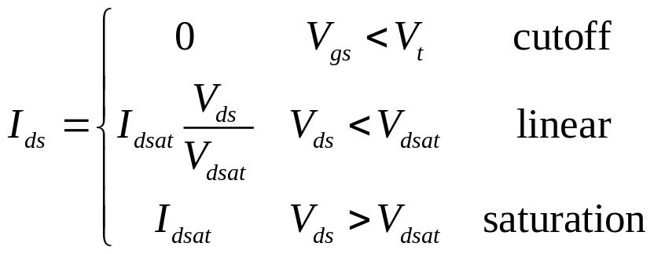
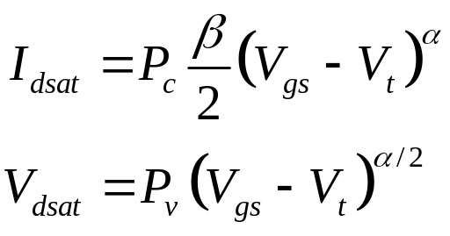
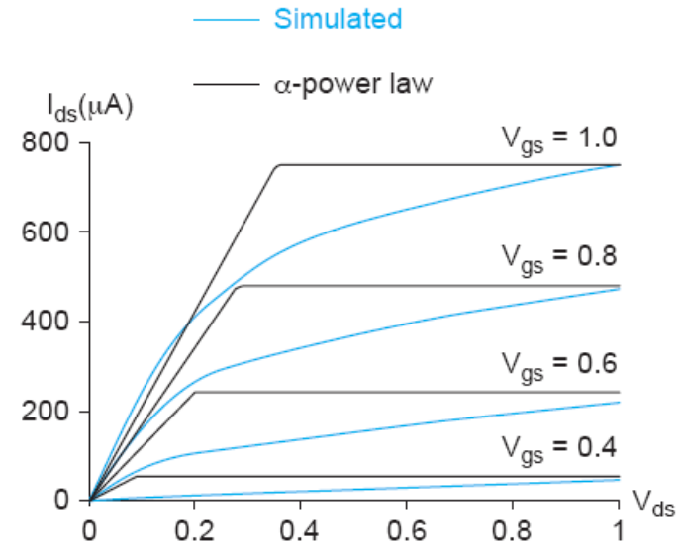
α-Power Model
Pc, Pv and α are found by fitting the model to the empirical modeling results
4: Nonideal Transistor Theory

Slide 15
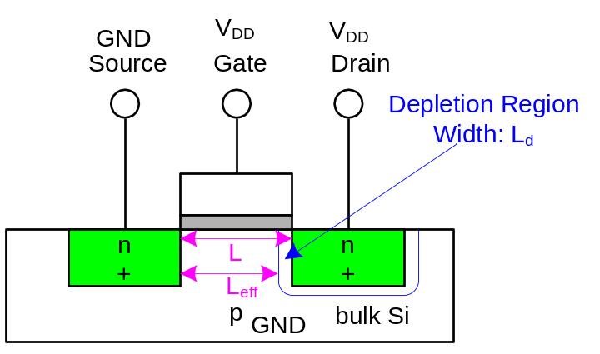
Channel Length Modulation
Reverse-biased p-n junctions form a depletion region
  Region between n and p with no carriers
  Width of depletion L_{d} region grows with reverse bias
  L_{eff} = L – L_{d}
Shorter L_{eff} gives more current
  I_{ds} increases with V_{ds}
  Even in saturation
4: Nonideal Transistor Theory

Slide 16
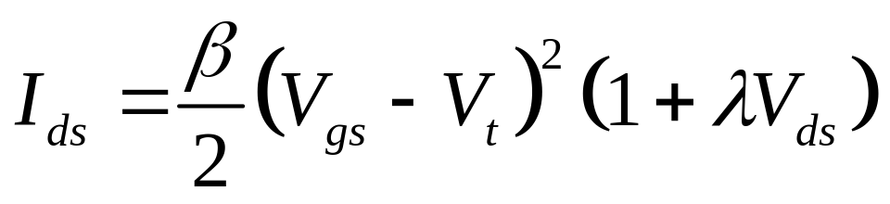
Channel Length Mod I-V
λ = channel length modulation coefficient
  not feature size
  Empirically fit to I-V characteristics
4: Nonideal Transistor Theory

Slide 17
Threshold Voltage Effects
V_{t} is V_{gs} for which the channel starts to invert
Ideal models assumed V_{t} is constant
Really depends (weakly) on almost everything else:
  Body voltage: Body Effect
  Drain voltage: Drain-Induced Barrier Lowering
  Channel length: Short Channel Effect
4: Nonideal Transistor Theory

Slide 18

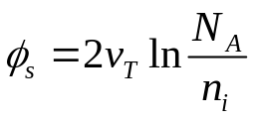
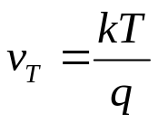
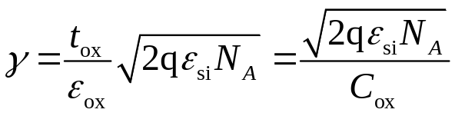
Body Effect
Body is a fourth transistor terminal
V_{sb} affects the charge required to invert the channel
  Increasing V_{s} or decreasing V_{b} increases V_{t}
φ_{s} = surface potential at threshold
  Depends on doping level N_{A}
  And intrinsic carrier concentration n_{i}
γ = body effect coefficient
4: Nonideal Transistor Theory
Notes:
Boltzmann constant , 1.3806505(24) × 10^-23 J/K

Slide 19
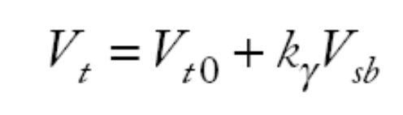
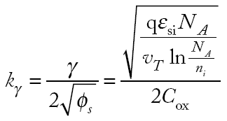
Body Effect Cont.
For small source-to-body voltage, treat as linear
4: Nonideal Transistor Theory

Slide 20
DIBL
Electric field from drain affects channel
More pronounced in small transistors where the drain is closer to the channel
Drain-Induced Barrier Lowering
  Drain voltage also affect V_{t}
High drain voltage causes current to increase.
DIBL increases subthreshold leakage at high Vds
4: Nonideal Transistor Theory

Slide 21
Short Channel Effect
In small transistors, source/drain depletion regions extend into the channel.
  Impacts the amount of charge required to invert the channel.
  And thus makes V_{t} a function of channel length.
Short channel effect: V_{t} increases with L.
  Some processes exhibit a reverse short channel effect in which V_{t} decreases with L.
  This is called Reverse Short Channel Effect (RSCE).
4: Nonideal Transistor Theory

Slide 22
Leakage
What about current in cutoff?
Simulated results
What differs?
  Current doesn’t
  go to 0 in cutoff
_{Tunnel current}
_{polysilicon}
_{gate}
_{W}
_{t}
_{ox}
_{n+}
_{L}
_{n+}
_{Subthreshold conduction}
_{p-type body}
_{Junction leakage}
4: Nonideal Transistor Theory

Slide 23
Leakage Sources
Subthreshold conduction
  Transistors can’t abruptly turn ON or OFF
  Dominant source in contemporary transistors
Gate leakage
  Tunneling through ultrathin gate dielectric
Junction leakage
  Reverse-biased PN junction diode current
4: Nonideal Transistor Theory

Slide 24
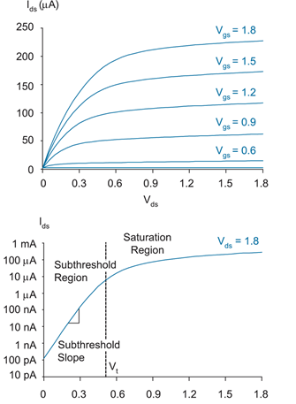
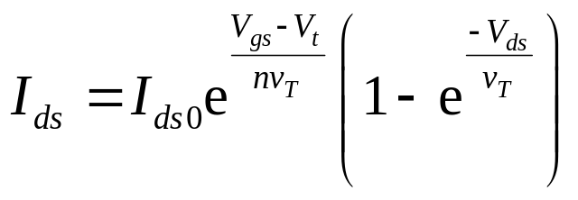

Subthreshold Leakage
_{Tunnel current}
_{polysilicon}
_{gate}
_{W}
_{t}
_{ox}
_{n+}
_{L}
_{n+}
_{Subthreshold conduction}
_{p-type body}
_{Junction leakage}
Subthreshold leakage is the biggest source in modern transistors
_{180nm process}
_{Vgs}
_{n = 1.4-15}
4: Nonideal Transistor Theory

Slide 25
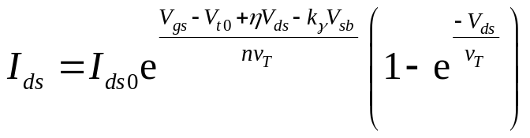
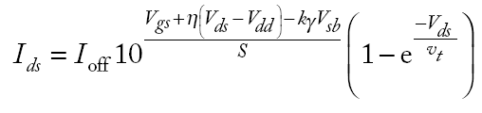
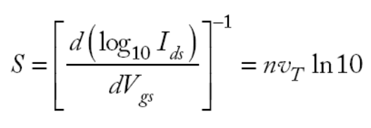
Subthreshold Leakage
Subthreshold leakage exponential with V_{gs}
n is process dependent
  typically 1.3-1.7
Rewrite relative to I_{off} on log scale
S ≈ 100 mV/decade @ room temperature
4: Nonideal Transistor Theory

Slide 26
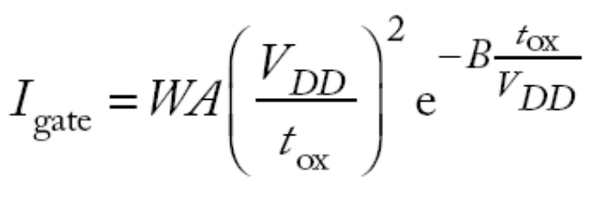
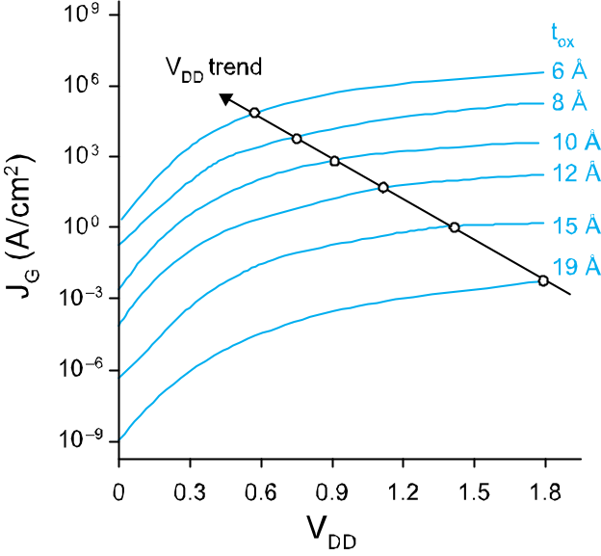
Gate Leakage
Carriers tunnel through very thin gate oxides
Exponentially sensitive to t_{ox} and V_{DD}
  A and B are tech constants
  Greater for electrons
    So nMOS gates leak more
Negligible for older processes (t_{ox} > 20 Å)
Critically important at 65 nm and below (t_{ox} ≈ 10.5 Å)
_{From [Song01]}
4: Nonideal Transistor Theory

Slide 27
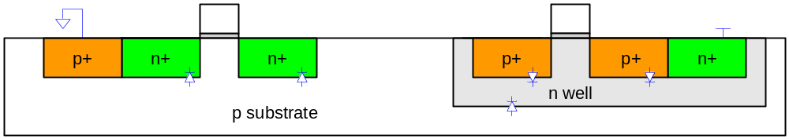
Junction Leakage
Reverse-biased p-n junctions have some leakage
  Ordinary diode leakage
  Band-to-band tunneling (BTBT)
  Gate-induced drain leakage (GIDL)
4: Nonideal Transistor Theory

Slide 28
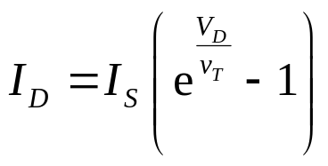
Diode Leakage
Reverse-biased p-n junctions have some leakage
At any significant negative diode voltage, I_{D} = -I_{s}
I_{s} depends on doping levels
  And area and perimeter of diffusion regions
  Typically < 1 fA/μm² (negligible)
4: Nonideal Transistor Theory

Slide 29
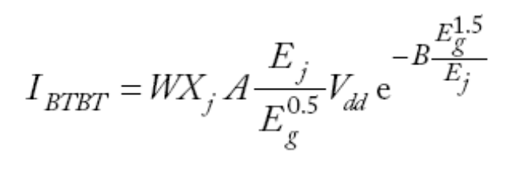
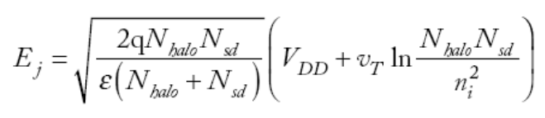
Band-to-Band Tunneling
Tunneling across heavily doped p-n junctions
  Especially sidewall between drain & channel
  when halo doping is used to increase V_{t}
Increases junction leakage to significant levels
  X_{j}: sidewall junction depth
  E_{g}: bandgap voltage
  A, B: tech constants
4: Nonideal Transistor Theory

Slide 30
Gate-Induced Drain Leakage
Occurs at overlap between gate and drain
  Most pronounced when drain is at V_{DD}, gate is at a negative voltage
  Thwarts efforts to reduce subthreshold leakage using a negative gate voltage
Gate-Induced Drain Leakage (GIDL).
4: Nonideal Transistor Theory

Slide 31
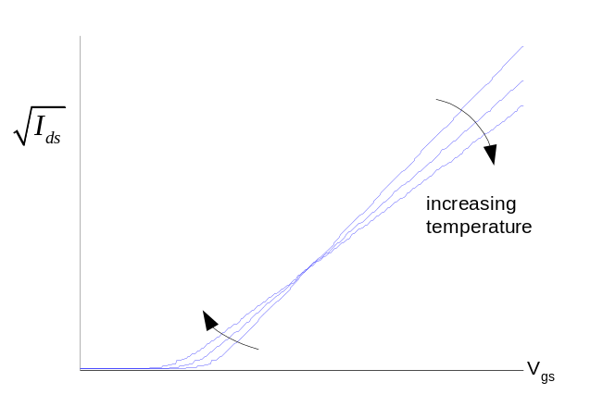
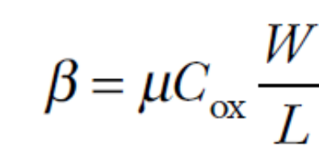
Temperature Sensitivity
Increasing temperature
  Reduces mobility
  Reduces V_{t}
I_{ON} decreases with temperature
I_{OFF} increases with temperature
4: Nonideal Transistor Theory

Slide 32
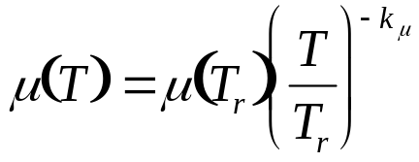

Temperature Sensitivity
The mobility changes by
  k_{μ} is a fitting parameter with a typical value 1.5
v_{sat} decreases with temperature, dropping by about 20% from 300 to 400K.
The magnitude of the threshold voltage decreases nearly linearly with temperature as
  k_{vt} is typically about 1-2 mV/K
4: Nonideal Transistor Theory

Slide 33
So What?
So what if transistors are not ideal?
  They still behave like switches.
But these effects matter for…
  Supply voltage choice
  Logical effort
  Quiescent power consumption
  Pass transistors
  Temperature of operation
4: Nonideal Transistor Theory

Slide 34
So What?
Velocity saturation and mobility degradation result in less than expected current at high voltage.
  There is no point in trying to use high V_{DD} for speed.
  Moreover, short channels and thin gate oxides will be damaged by high V_{DD}.
Series transistors divide voltage. Thus, they are faster than a single transistor contrary to expected.
4: Nonideal Transistor Theory

Slide 35

Parameter Variation
Transistors have uncertainty in parameters
  Process: L_{eff}, V_{t}, t_{ox} of nMOS and pMOS
  Vary around typical (T) values
Fast (F)
  L_{eff}: short
  V_{t}: low
  t_{ox}: thin
Slow (S): opposite
Not all parameters are independent
for nMOS and pMOS
4: Nonideal Transistor Theory

Slide 36
Environmental Variation
V_{DD} and T also vary in time and space
Fast:
  V_{DD}: high
  T: low
Corner | Voltage | Temperature
F | 1.98 | 0 C
T | 1.8 | 70 C
S | 1.62 | 125 C
4: Nonideal Transistor Theory

Slide 37
Process Corners
Process corners describe worst case variations
  If a design works in all corners, it will probably work for any variation.
Describe corner with four letters (T, F, S)
  nMOS speed
  pMOS speed
  Voltage
  Temperature
4: Nonideal Transistor Theory

Slide 38

Important Corners
Some critical simulation corners include
Purpose | nMOS | pMOS | VDD | Temp
Cycle time | S | S | S | S
Power | F | F | F | F
Subthreshold leakage | F | F | F | S
4: Nonideal Transistor Theory

